Slide 1
Welcome Partner Agencies!
2014 Agency Networking Conference
Monday, May 12, 2014 - Brewer

Slide 2
Welcome & Introductions
Framing the Day
Accomplishments & Challenges
Kathy Helming, Vice President of Agency Services
Kristen Miale, President

Slide 9
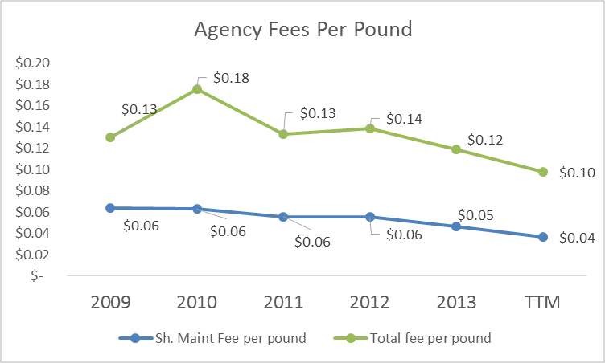

Slide 10
Identifying Community Partnerships Building Community Awareness & Fundraising Strategies
Panelists:
Melvin Voisine, Lincoln Community Food Pantry
Wendy Harrington, Maine Sea Coast Mission, Cherryfield
Kate Sebelin, Bar Harbor Food Pantry
Rick Traub, Tree of Life Food Pantry, Blue Hill

Slide 11
Strategies for Moving Food More Efficiently and to More People Prioritizing Nutritious Foods
Panelists:
Brenda Leavitt, Brewer Area Food Pantry
Sara Trunzo, Veggies for All/Maine Farmland Trust
Bob VanDeventer, Volunteer Regional Food Pantry, Unity
Hannah Semler, Healthy Acadia

Slide 12
Lunch Presentation
Courtney Kennedy, Nutrition & Education Manager
Nancy Perry, Food Sourcing & Mainers Feeding Mainers Manager

Slide 13
Connecting the Dots: Identifying our Shared Challenges, Needs & Opportunities

Slide 14
Birds of a Feather: Round Table Discussion & Peer Conversations

Slide 15
Thank you!

