Slide 1
It is not necessary to use this PowerPoint as part of your online program, but if you choose to do so, this template aligns with the outline and activities in Drink to Your Health: Tasty, Lower-sugar Choices for Kids and Caregivers
Because there are some differences in how partners implement Cooking Matters, you may need to customize some of the slides to ensure the information is relevant for your participants and technology. We ask that you do not remove the first three slides or the last four slides, but you may edit the slides as necessary.
There are multiple recipes included in these slides, but we only recommend including 1 live recipe demonstration in a 30-minute lesson. Remember to hide any recipe or other slides you are not using before presenting. Feel free to use any recipe provided in the slides or choose another recipe from Cooking Matters. Most of the recipes included in this deck have matching YouTube videos in case you are unable to lead a live cooking demonstration and would rather play a video. If you do so, we recommend muting the video sound and narrating the recipe steps yourself.
Make sure you delete or hide this slide and any other unused slides before showing this presentation. Not sure how to hide slides? Click here for support.

Slide 2
Welcome!
Introduction
Expectations – please participate!
Online Logistics
Let's get to know each other! – Please share:
  What age are your kids? Infants? Toddlers or preschoolers? School-aged children? Teenagers? Grown-ups?
  What are you looking forward to learning in this session?
Notes:
Introduction (5 minutes):
Share if this session will be recorded or not!
Welcome caregivers. Introduce instructors and any other volunteers or helpers.
Set expectations and open environment. Explain that caregivers will learn how to prepare quick and healthy snacks at home with their kids, and get some tips on saving time and money.
Virtual logistics.
Mute your audio when you aren’t speaking. While we’d love your input, muting your audio at other times minimizes background noise so that everyone can hear clearly.
Be respectful of presenters and other attendees. Try not to interrupt others when they’re speaking.
Please participate! We want to make this tour relevant to you, so please respond with your comments or questions. If speaking is disabled or you feel more comfortable, you can also type your responses or questions into the chat box as well. Enabling your camera is optional.
Get to know each other
ASK: How old are your kids? Infants? Toddlers or preschoolers? School-aged children? Teenagers? Grown ups?” Make note of this information so you can focus on sharing tips that are most relevant for the age groups represented.

Slide 3
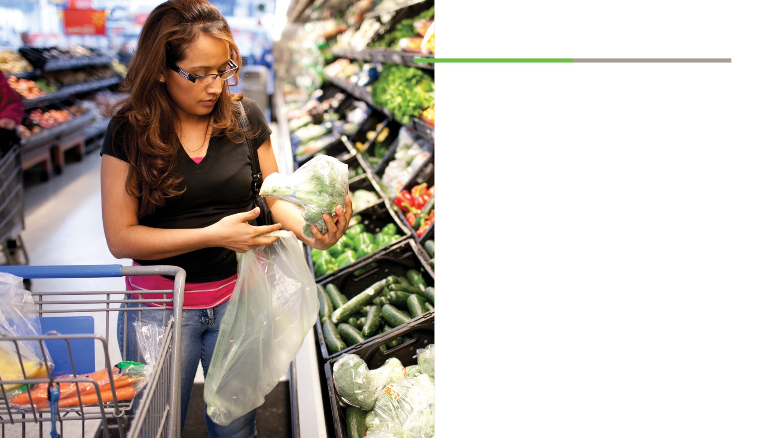
What we will do today
Understand how sugary drinks impact health.
Learn about variety of healthy beverages that you can make at home.
Practice identifying sugar on the Nutrition Facts Panel.
Notes:
Introduction continued:
KEY MESSAGES
Drinking more water and low-sugar drinks can help your kids avoid tooth decay, cavities, and other health problems – all while saving you money.
You can make drinks at home with a few ingredients commonly found in the WIC package.
Make your own drinks at home together – it’s an activity for you and your kids to enjoy, and builds healthy habits.

Slide 4
Please share:
What do you like to drink?
What beverages did you buy this week for yourself and for your kids?
Which of these drinks do you wish you or your kids drank less of? More of? Why?
Notes:
Write down caregivers’ examples. Remind caregivers that the main reason we drink beverages in terms of nutrition is to hydrate, or make sure our bodies get enough water. Kids need water for recharging after sports, activities, and play time. Often our beverages contain water, but they may also contain a lot of sugar. Sugary drinks can lead to a variety of health concerns like early tooth decay and cavities, and can lead to other health concerns, like diabetes or prediabetes, in the future.

Slide 5
How can you tell which drinks have more sugar than others?
Notes:
Point out that packaging and terms like “organic” or “natural” do not necessarily mean a drink is more nutritious. To check nutrition content, you have to look at the Nutrition Facts Label.

Slide 6
Notes:
Let caregivers share what they know about reading Nutrition Facts labels. As needed, review the Reading Food Labels Handout. Point out that a bottle or package of juice, soda, or flavored water often contains more than one serving per bottle. Show caregivers where the serving size and servings per container are listed at the top of the label. Point out where they can find the sugar content of the beverage.
Have caregivers compare labels of various popular beverages, especially those typically offered to kids (e.g., juice, sports drinks, fruit-flavored “juices,” flavored milks, etc.). If children are included, encourage caregivers to find ways to engage them in comparing labels. If they are able to identify colors or numbers, have caregivers ask kids to share what numbers they see and what colors they see on the package. If they are old enough to read, have the children support the caregivers in reading the labels and offering their ideas. (SEE FOLLOWING SLIDES for OPTIONS)

Slide 7
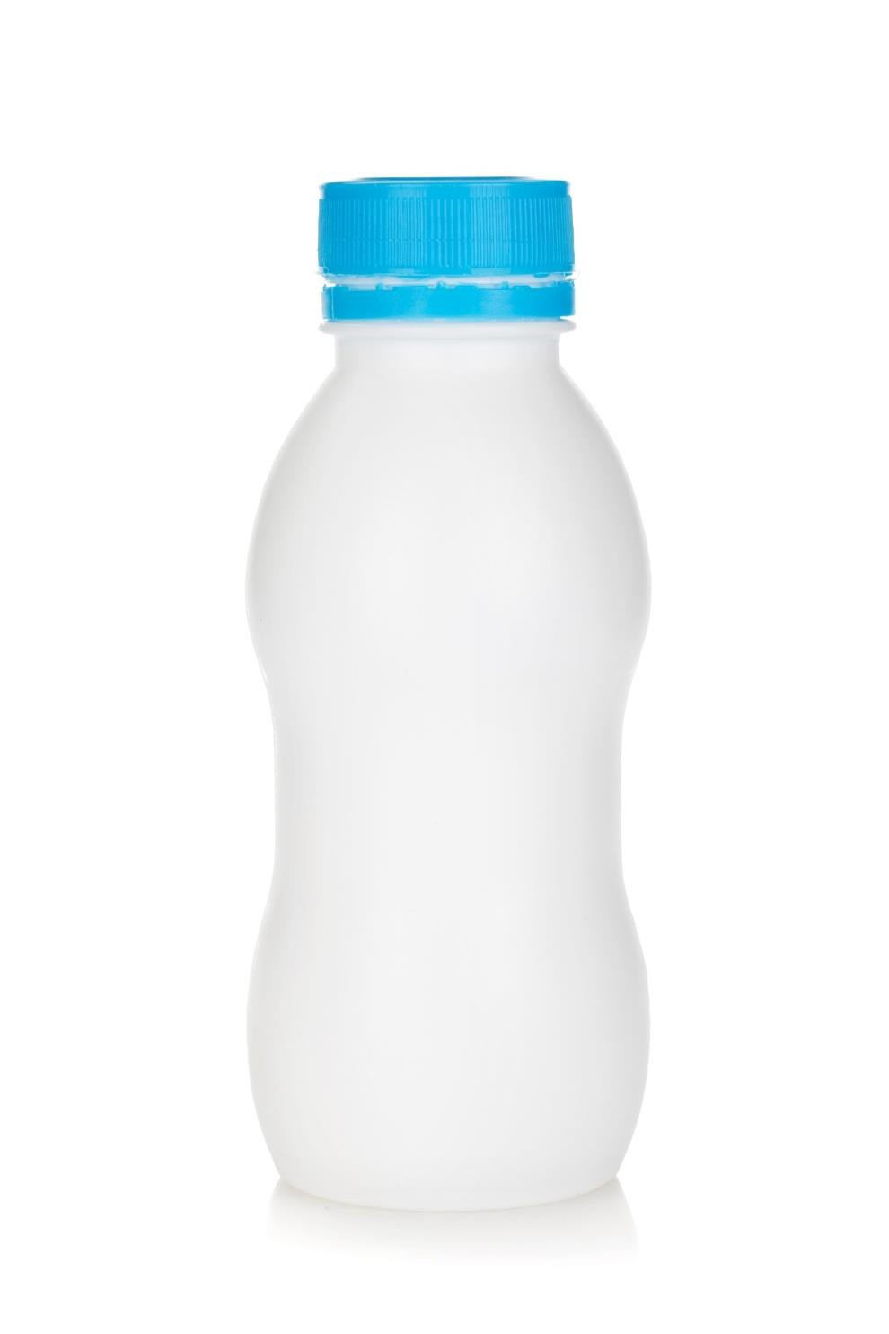
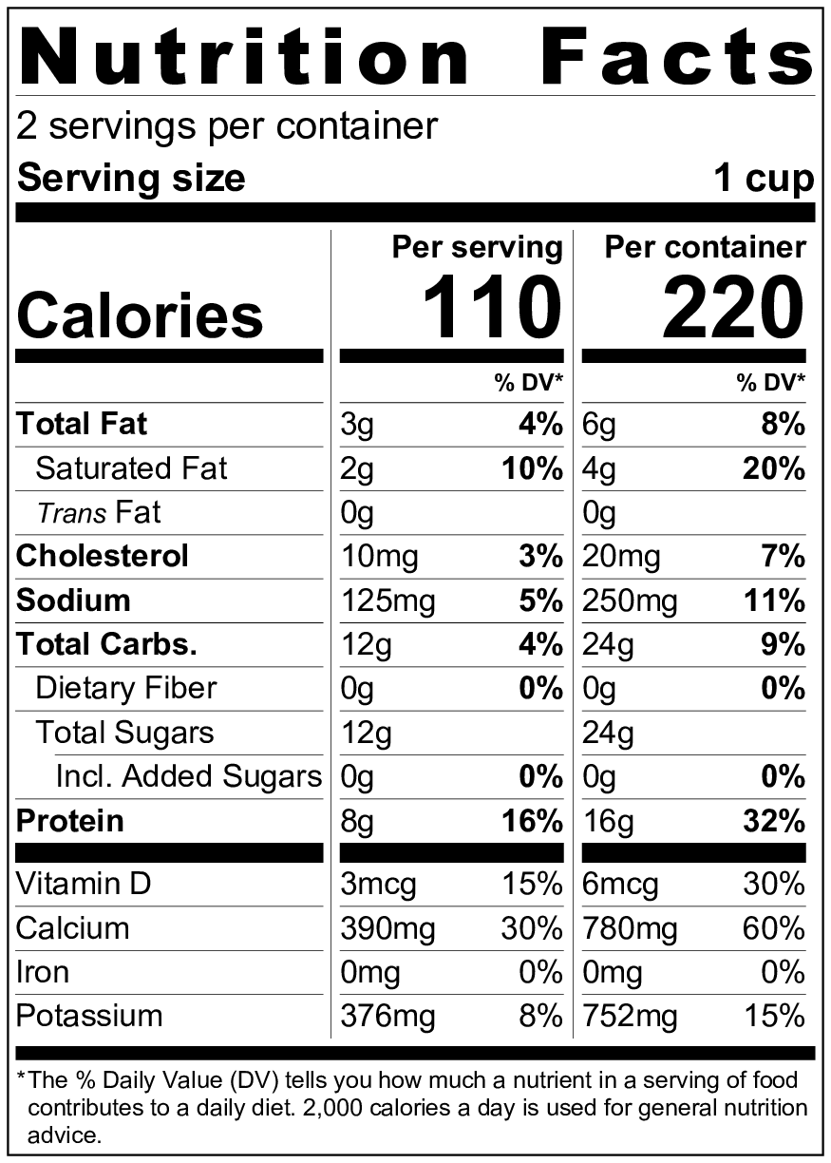


Milk
Low-fat
UNIT PRICE $8.72 PER GALLON | RETAIL PRICE
 | $1.09
Low-fat Milk (1 Pint)
00 oz
$0.00
unit
0.00
Item Name
Ingredients:
Low-fat Milk, Vitamin A Palmitate, Vitamin D3

Slide 8
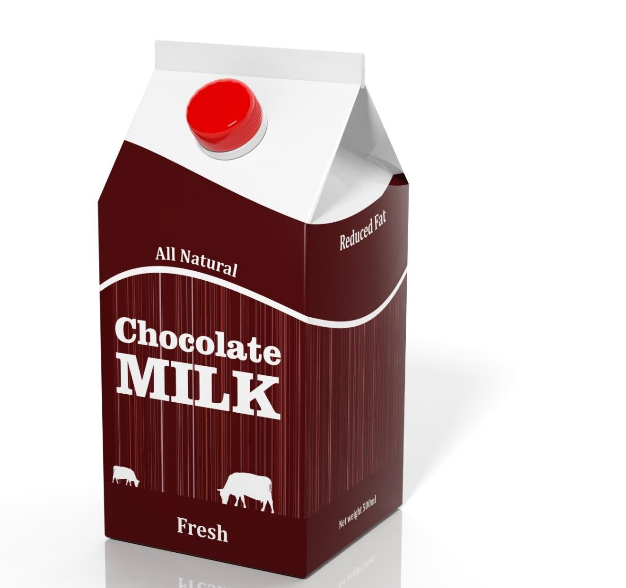
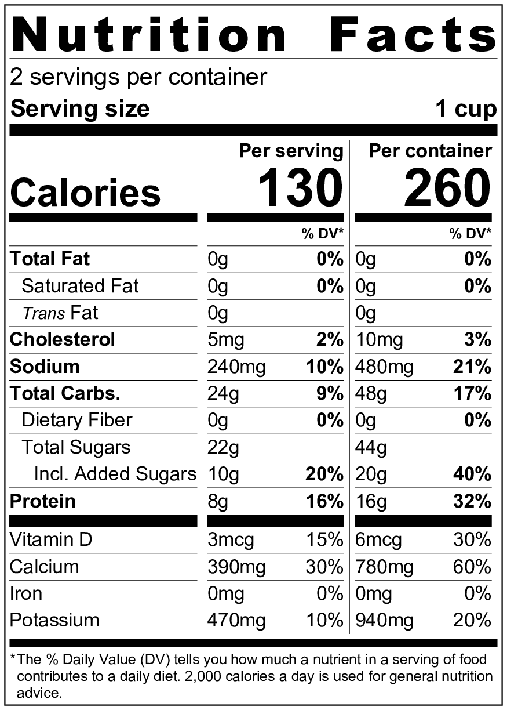
UNIT PRICE $14.40 PER GALLON | RETAIL PRICE
 | $1.80
Fat-free Chocolate Milk (1 pint)
00 oz
$0.00
unit
0.00
Item Name
Ingredients:
Fat-free Milk, Sugar, Cocoa processed with Alkali, Corn Starch, Salt, Carrageenan, Vanillin (an artifical flavor), Vitamin A Palmitate, Vitamin D3

Slide 9

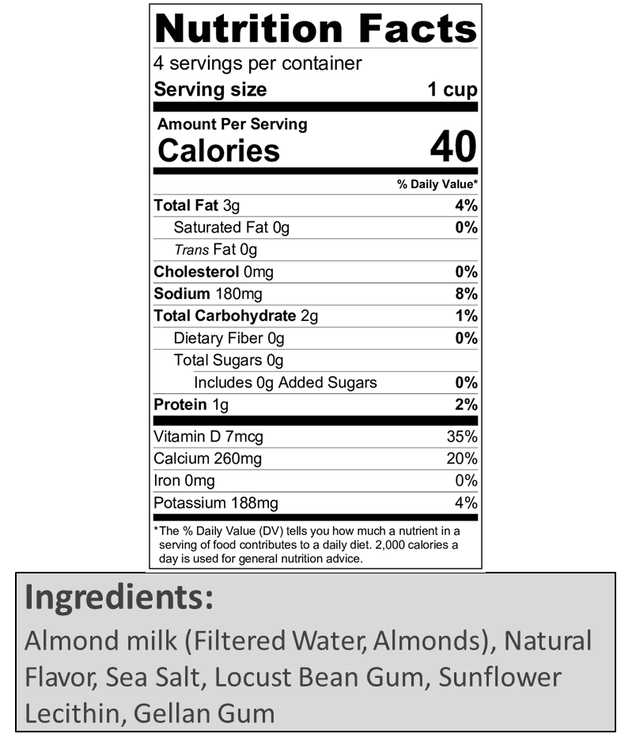
UNIT PRICE $10.36 PER GALLON | RETAIL PRICE
 | $2.59
Almond Milk (1 Quart)
00 oz
$0.00
unit
0.00
Item Name

Slide 10
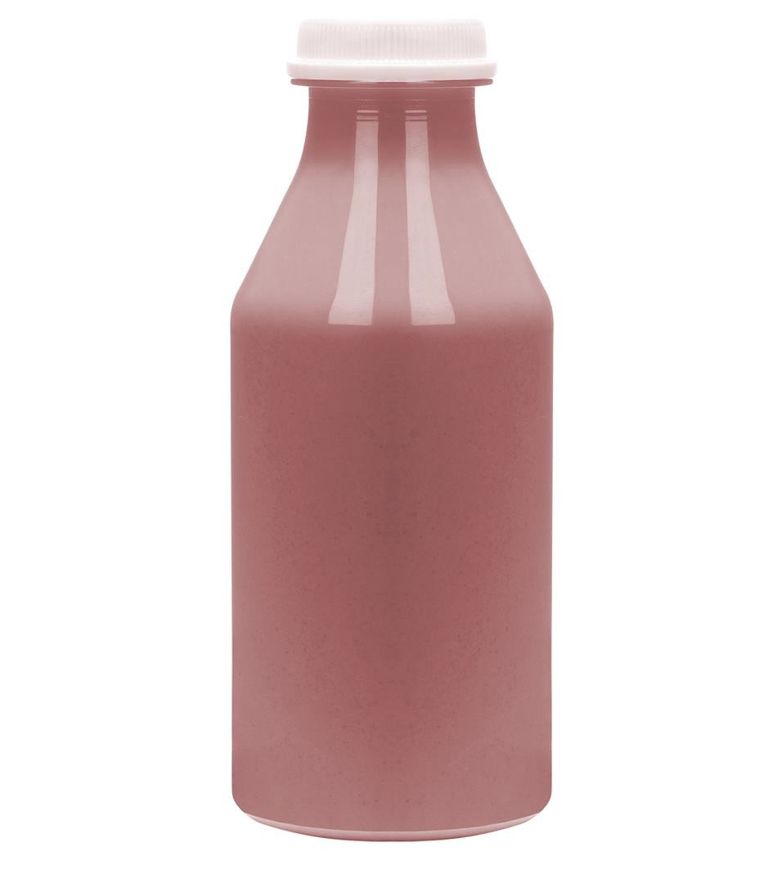
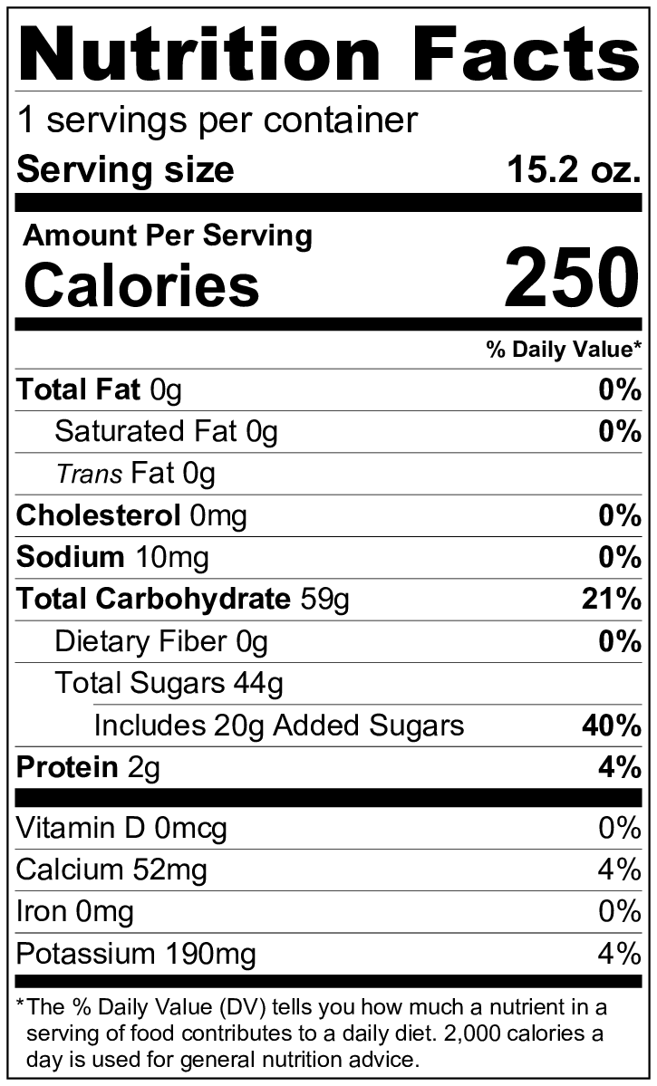


UNIT PRICE $0.14 PER OUNCE | RETAIL PRICE
 | $2.19
Strawberry Banana Smoothie (15.2 oz.)
00 oz
$0.00
unit
0.00
Item Name
Ingredients:
Strawberry puree, apple juice, banana puree, orange juice, natural flavors

Slide 11
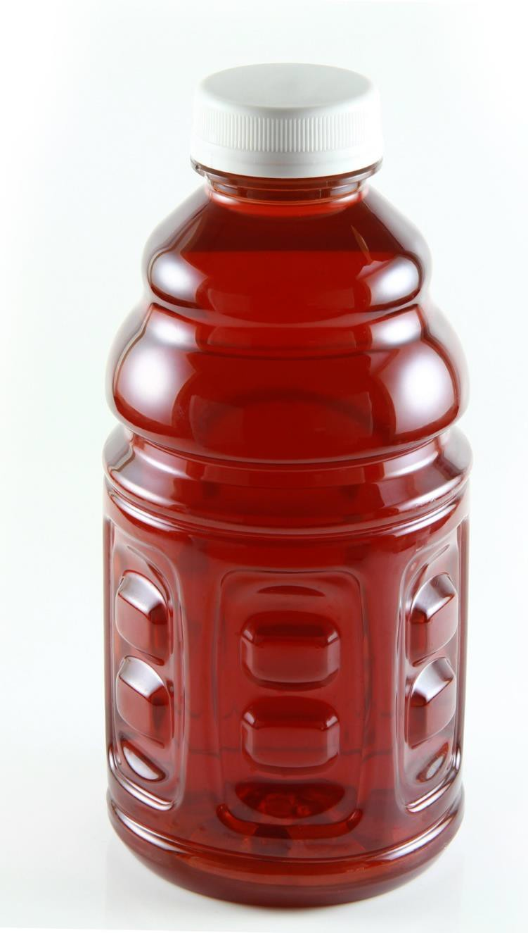
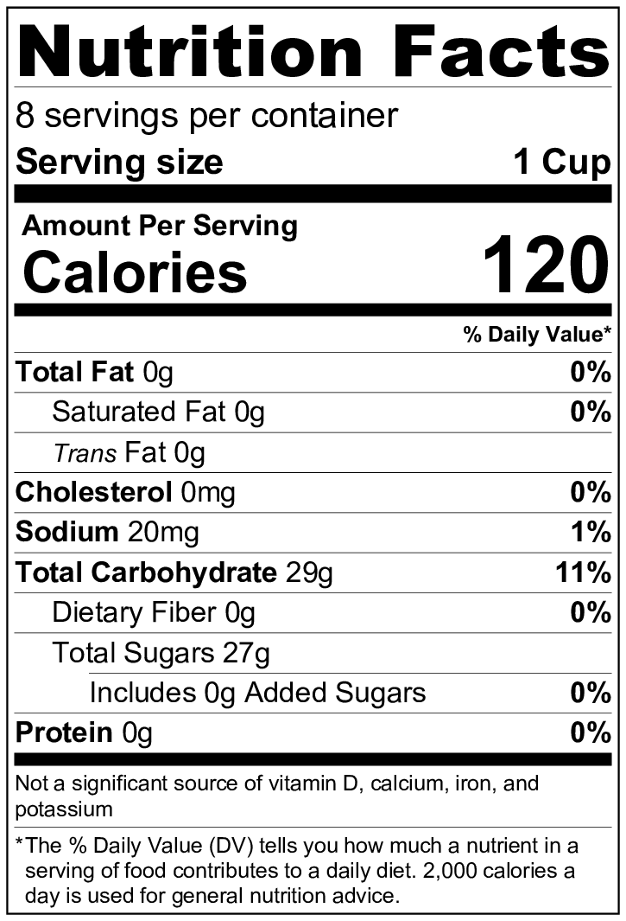
Mixed BERRY
Juice
UNIT PRICE $5.58 PER GALLON | RETAIL PRICE
 | $2.79
100% Mixed Berry Juice (64 oz.)
00 oz
$0.00
unit
0.00
Item Name
Ingredients:
Apple Juice, Pear Juice, Grape Juice, and Raspberry Juice (Water, Juice Concentrates), Natural Flavors, Ascorbic Acid (Vitamin C), Citric Acid.

Slide 12

Cranberry Cocktail
UNIT PRICE $5.00 PER GALLON | RETAIL PRICE
 | $2.50
Cranberry Cocktail, 27% Juice (64 oz.)
00 oz
$0.00
unit
0.00
Item Name
Ingredients:
Filtered Water, High Fructose Corn Syrup, Grape Juice Concentrate, Sugar, Cranberry Juice Concentrate, Fumaric Acid, Natural Flavors, Sodium Citrate, Ascorbic Acid (Vitamin C), Red 40 and Blue 1 (Colors).

Slide 13
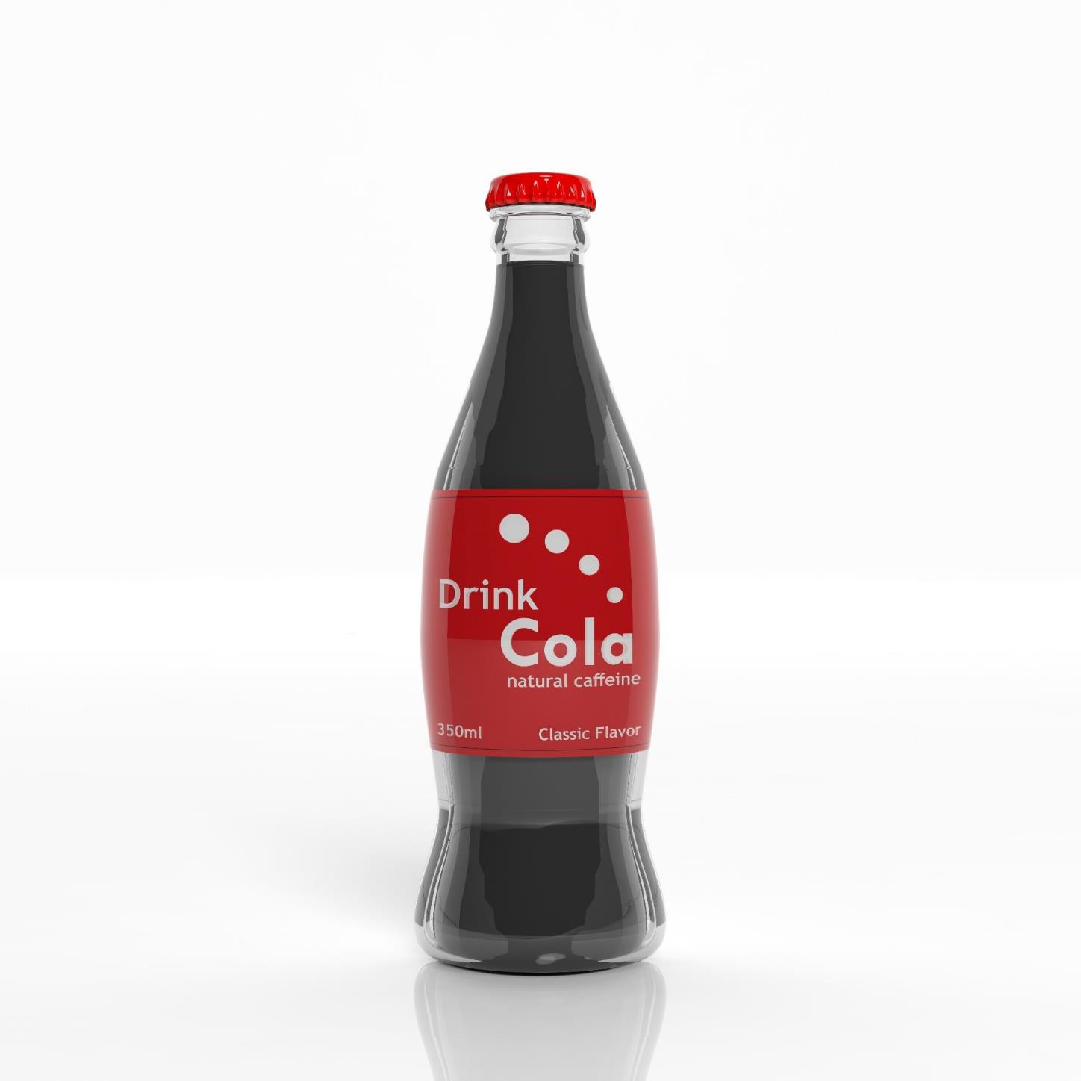
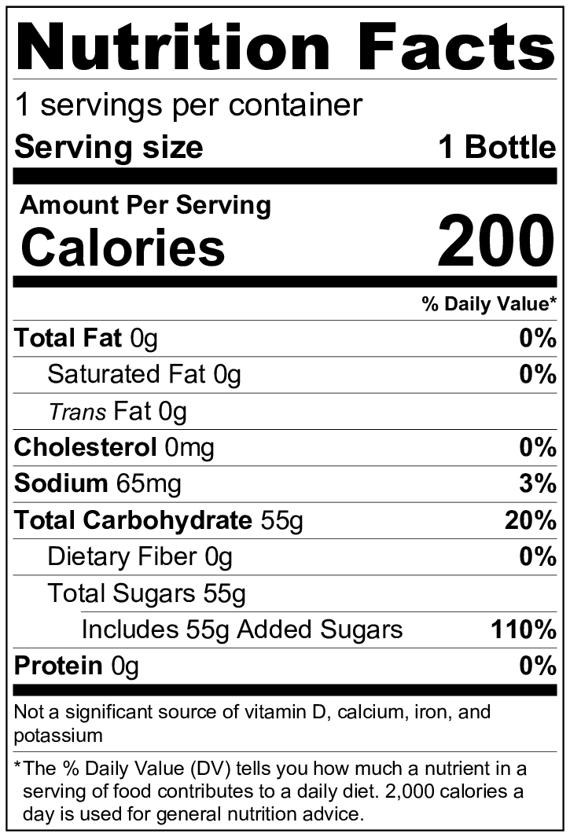
UNIT PRICE $9.01 PER GALLON | RETAIL PRICE
 | $1.19
Soft Drink (16.9 oz.)
00 oz
$0.00
unit
0.00
Item Name
Ingredients:
Carbonated Water, High Fructose Corn Syrup, Citric Acid, Sodium Benzoate (Preservative), Natural Flavors, Caramel Color.

Slide 14

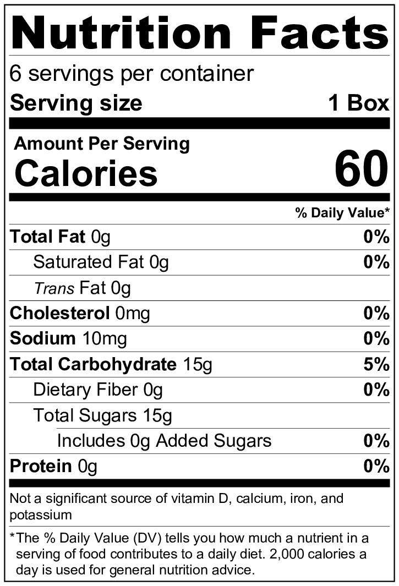
UNIT PRICE $20.76 PER GALLON | RETAIL PRICE
 | $3.99
100% Juice Box (6 pk., 4.1 oz.)
00 oz
$0.00
unit
0.00
Item Name
Ingredients:
Apple Juice, Pear Juice, Grape Juice, and Raspberry Juice (Water, Juice Concentrates), Natural Flavors, Ascorbic Acid (Vitamin C), Citric Acid.

Slide 15
Notes:
If time permits, you can add to the label reading activity by measuring the sugar to create a visual amount for each beverage. You can find the details to complete this in the Sugar Overload activity at the end of the lesson.

Slide 16
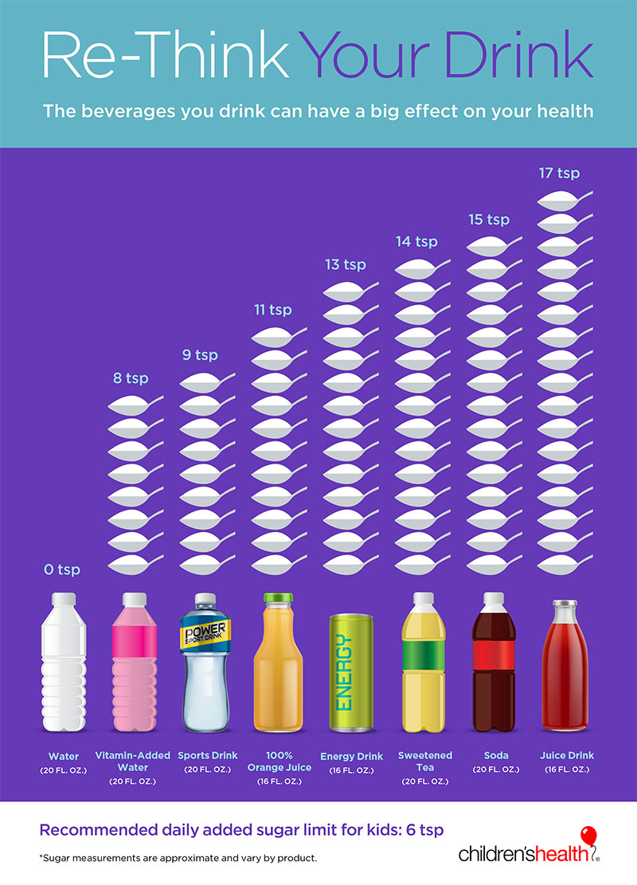
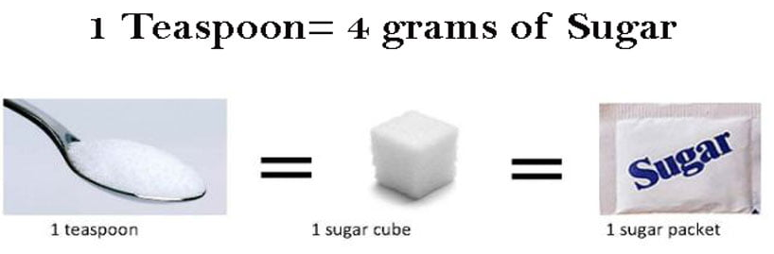
How many sugar packets/teaspoons of sugar are in each drink?
Notes:
Remember 3 teaspoons (tsp) = 1 tablespoon, 4 tablespoons = ¼ cup
Answer in order:
0; 2 tsp; 2 ¼ tsp; 2 ¾ tsp; 3 ¼ tsp ; 3 ½ tsp; 3 ¾ tsp; 4 ½ tsp.

Slide 17
Notes:
If time permits,
Explain that sugar isn’t always called ‘sugar’ in the ingredient lists. For example, we know soda is sweet, but the word ‘sugar’ isn’t listed in the ingredients.
Have caregivers find other names for sugars on the labels they are reading. Refer caregivers to the Cut Back on Added Sugar handout for a list of common sugars.

Slide 18
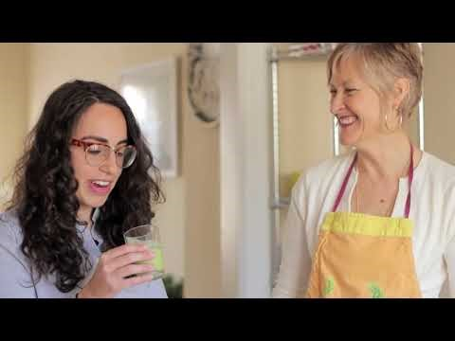
Recipe: Smoothies
You can find more great videos on our YouTube Channel: Cooking Matters By Share Our Strength
Notes:
Draw attention to ways that drinks made at home can help you save money, be participatory for your children, help introduce new foods, or even serve as on-the-go meals, e.g. smoothies. There are a variety of beverages you can make at home with a few versatile ingredients commonly found in the WIC package.

Slide 20
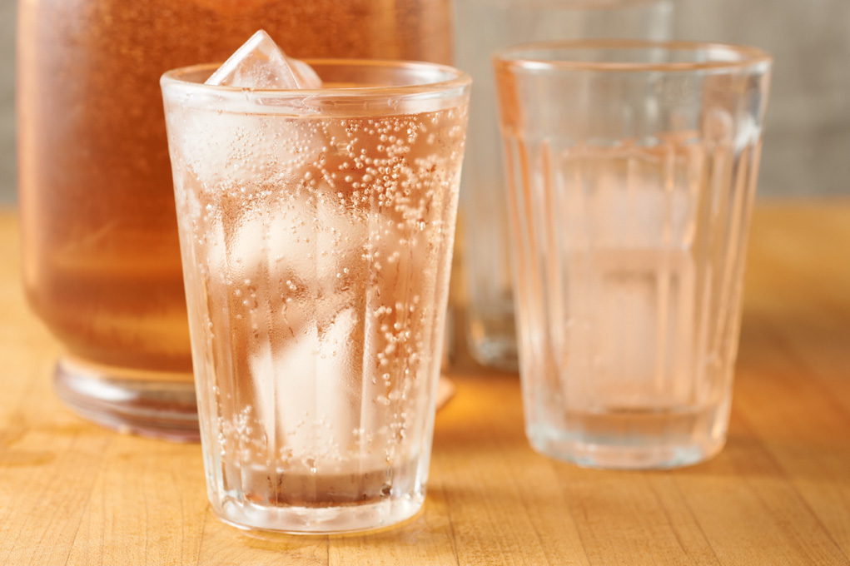
Raspberry Lime Fizz

Slide 21
What makes it challenging for you and/or your kids to drink water or other healthy beverages more often?
Why do you choose to buy and drink sugary beverages?
Notes:
Address 1-2 common challenges and let caregivers offer each other ideas to overcome those challenges. Use the following table to offer additional ideas as needed. Address other challenges as time permits.

Slide 22
Please share:
What ideas or tips have you used in your household to switch to lower sugar beverages?
Notes:
Affirm caregiver responses and share additional tips as needed.
Reduce how much sugar you add to coffee, tea, or other drinks one packet at a time.
Ween kids off of high-sugar drinks. Mix water with juice or fruit-flavored juices. Over time, gradually increase the amount of water in the mixture.
Make sugar-sweetened beverages only for special occasions, like birthday parties or long road trips.
Be a good role model. If kids see you drinking and enjoying more water yourself, they’ll get the message that sugar-sweetened beverages are not “every day” drinks.
Make fun ice cubes with kids that have a little lemon or lime juice and some frozen berries. They look great and add interest to water.
Freeze water into popsicle molds (because even just a water ice pop is fun!)

Slide 23

Today’s Top Tips
Drinking more water and low-sugar drinks can help your kids avoid tooth decay, cavities, and other health problems – all while saving you money.
You can make drinks at home with a few ingredients commonly found in the WIC package.
Make your own drinks at home together – it’s an activity for you and your kids to enjoy, and builds healthy habits.
Notes:
ENCOURAGE: Encourage caregivers to choose one thing they learned today that they will commit to trying at home this week. Have them share aloud if they are willing.
ASK: Model how to get buy-in from kids on healthy beverages by asking kids to share with their caregivers their favorite part of today’s session, the best drink they tried, and/or a new drink they want to try making at home.
SHARE: Share with participants that they can download the Cooking Matters App or visit our website for more recipes, and point out the additional resources available on the Cooking Matters Facebook and YouTube pages. If possible, chat out the links to the group as you mention these resources. Share any upcoming programs.

Slide 24
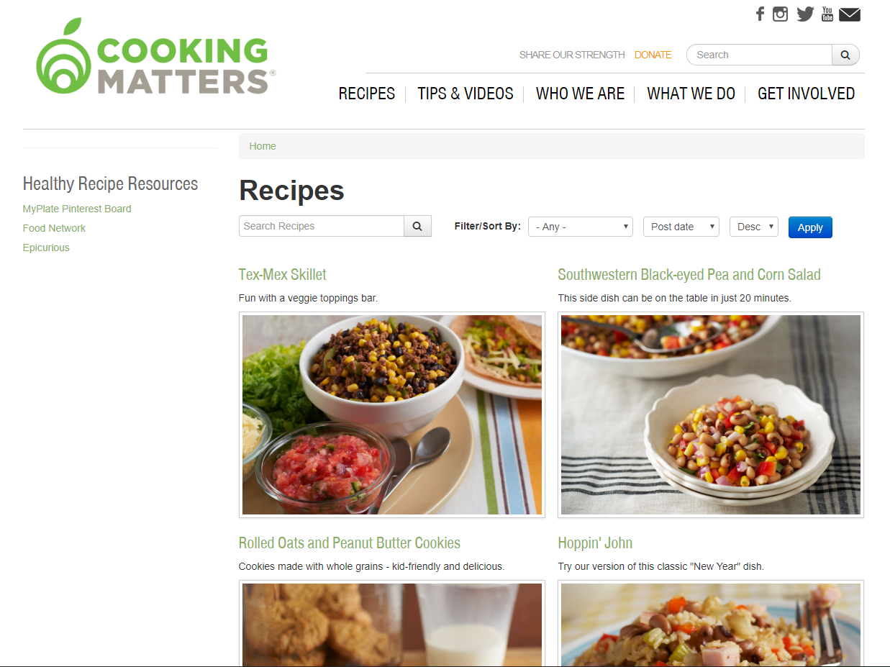
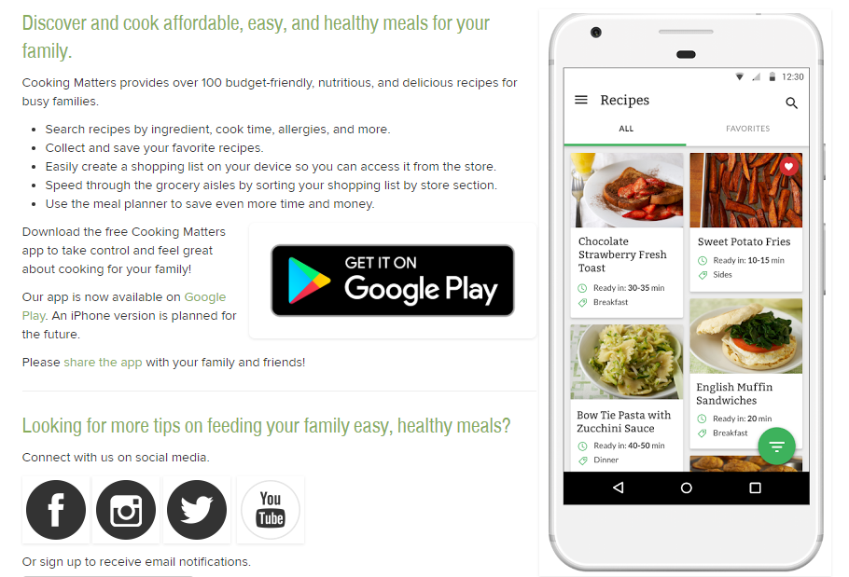
Recipe Resources
Cooking Matters App
Cookingmatters.org/recipes
Notes:
SHARE: Share with participants that they can download the Cooking Matters App for more recipes or go to the Cooking Matters website

Slide 25
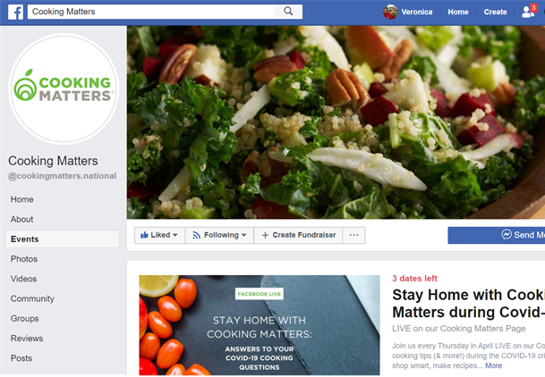

Recipe and Activity Resources
Cookingmatters.org/cooking-matters-home
Cooking Matters Facebook Page
Notes:
SHARE: Share with participants that they can download the Cooking Matters App for more recipes or go to Cooking Matters website.
Encourage participants with the following tips for making it work at home:
Fill your feeds with inspiration. It’s easier to stay motivated when you’ve got regular reminders and tips popping up on your social media feeds. Follow Cooking Matters or other channels that help you get closer to your goals.
Share what you’ve learned. Want other family members and friends to join you on this journey? Share something exciting you’ve learned — or better yet, feed them something delicious and healthy so they’ll know it’s true! Don’t pressure them — let them decide when they’re ready to take on new habits themselves.

Slide 26
Thank you!
After this session you will receive an e-mail with a quick survey and links to our resources.
If you have time, please fill out the survey to help us know who we are serving and how we can make our programs better!

Slide 27
Drink To Your Health: Tasty, Lower Sugar Choices for Kids and Caregivers
Coordinator Name
Notes:
Welcome participants as they arrive. While you wait for the full group, ask participants what they hope to learn in this lesson.

