Slide 1
It is not necessary to use this PowerPoint as part of your online program, but if you choose to do so, this template aligns with the outline and activities in The Family Kitchen: Cooking Up Lifelong Healthy Habits Together.
Because there are some differences in how partners implement Cooking Matters, you may need to customize some of the slides to ensure the information is relevant for your participants and technology. We ask that you do not remove the first three slides or the last four slides, but you may edit the slides as necessary.
There are multiple recipes included in these slides, but we only recommend including 1 live recipe demonstration in a 30-minute lesson. Remember to hide any recipe or other slides you are not using before presenting. Feel free to use any recipe provided in the slides or choose another recipe from Cooking Matters. Most of the recipes included in this deck have matching YouTube videos in case you are unable to lead a live cooking demonstration and would rather play a video. If you do so, we recommend muting the video sound and narrating the recipe steps yourself.
Make sure you delete or hide this slide and any other unused slides before showing this presentation. Not sure how to hide slides? Click here for support.

Slide 2
The Family Kitchen:
Cooking Up Lifelong Healthy Habits Together
Coordinator Name
Notes:
Welcome participants as they arrive. While you wait for the full group, ask participants what they hope to learn in this lesson.

Slide 3
Welcome!
Introduction
Expectations – please participate!
Online Logistics
Let's get to know each other! – Please share:
  What age are your kids? Infants? Toddlers or preschoolers? School-aged children? Teenagers? Grown-ups?
  What are you looking forward to learning in this session?
Notes:
Introduction (5 minutes):
Share if this session will be recorded or not!
Welcome caregivers. Introduce instructors and any other volunteers or helpers.
Set expectations and open environment. Explain that caregivers will learn how to prepare quick and healthy snacks at home with their kids, and get some tips on saving time and money.
Virtual logistics.
Mute your audio when you aren’t speaking. While we’d love your input, muting your audio at other times minimizes background noise so that everyone can hear clearly.
Be respectful of presenters and other attendees. Try not to interrupt others when they’re speaking.
Please participate! We want to make this tour relevant to you, so please respond with your comments or questions. If speaking is disabled or you feel more comfortable, you can also type your responses or questions into the chat box as well. Enabling your camera is optional.
Get to know each other
ASK: How old are your kids? Infants? Toddlers or preschoolers? School-aged children? Teenagers? Grown ups?” Make note of this information so you can focus on sharing tips that are most relevant for the age groups represented.

Slide 4

What we will do today
Discuss ways to help kids develop good eating habits through caregiver role modeling.
Discuss safe, age-appropriate tasks for kids in the kitchen.
Demonstrate preparing meals or snacks with child-friendly steps.
Notes:
Introduction continued:
SHARE: Acknowledge that feeding young children can be really challenging!
KEY MESSAGES
Make your job easier. Kids are more likely to try new foods when they help choose and prepare them.
Start young. Kids can help in the kitchen as early as their toddler years.
Keep calm and cook on – working with kids in the kitchen may be messy. The more you practice, the better you’ll get at figuring out what kitchen jobs are right for each of you.

Slide 5
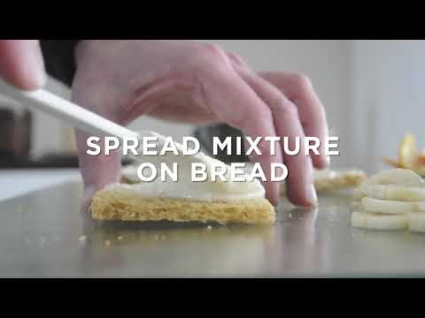
Recipe: Fruit Tarts
You can find more great videos on our YouTube Channel: Cooking Matters By Share Our Strength
Notes:
Show 1 video from The Family Kitchen 30 minute lesson list
After showing, ASK: What are some steps children can help with before, during or after this recipe?
Child and Chef Notes for Fruit Tarts: Kids can practice measuring and mixing – or they can roll out the bread for the tarts. If you do not have a rolling pan, kids will have fun just pressing the bread as flat as possible with a plate, cup, sauté pan, or just their hands! You can also use crackers instead of bread. Sub in any fruit you like – one of the greatest things about this snack is how nice it looks, and it will look even nicer to your kids if topped with fruits that they like to eat.

Slide 6
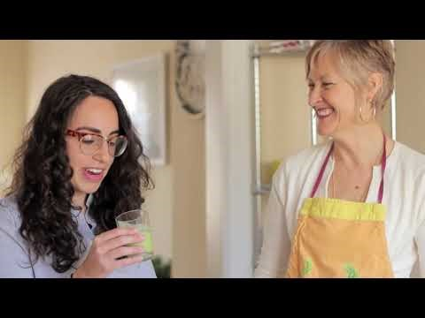
Recipe: Smoothies
You can find more great videos on our YouTube Channel: Cooking Matters By Share Our Strength
Notes:
After showing, ASK: What are some steps children can help with before, during or after this recipe?
Child and Chef Notes for Fruit Smoothies: Smoothies are a great healthy food for adapting to your kids’ specific tastes. You can buy ingredients that you know they like. Kids love to help out with recipes like smoothies – they can measure, add ingredients to the blender, and make the blender go “VROOM!” Another plus is that smoothies are usually a very well contained mess.

Slide 7
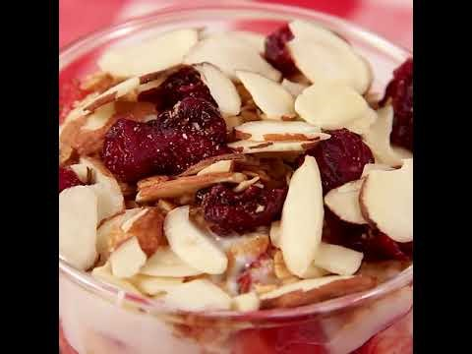
Recipe: Yogurt Parfaits
You can find more great videos on our YouTube Channel: Cooking Matters By Share Our Strength
Notes:
After showing, ASK: What are some steps children can help with before, during or after this recipe?
Child and Chef Notes for Yogurt Parfaits: Sub in any fruit you like – one of the greatest things about this snack is how nice it looks, and it will look even nicer to your kids if topped with fruits that they like to eat. These parfaits are very easy for kids to assemble independently, which gives them a sense of ownership and a tendency to eat more.

Slide 8
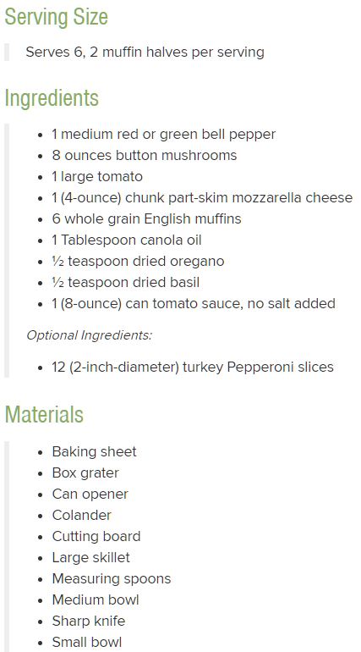
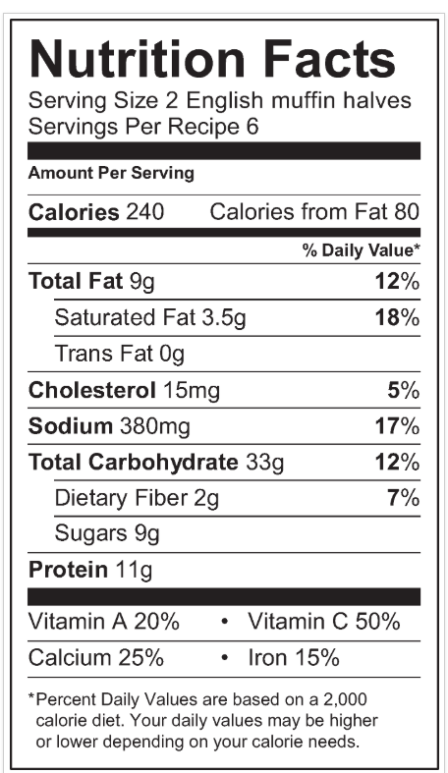
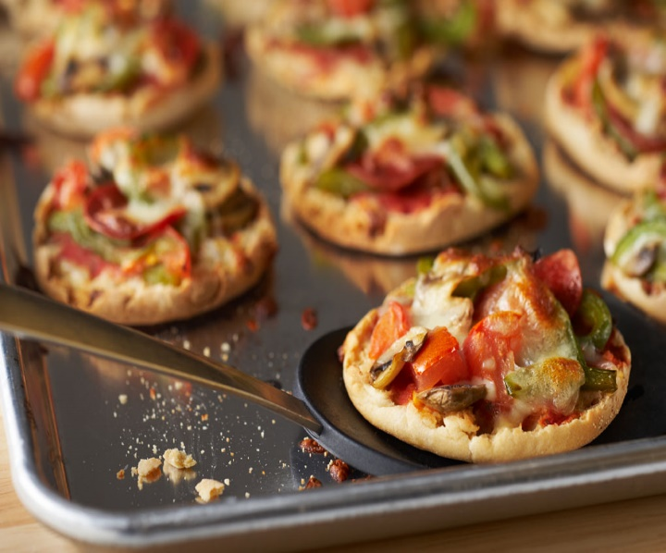
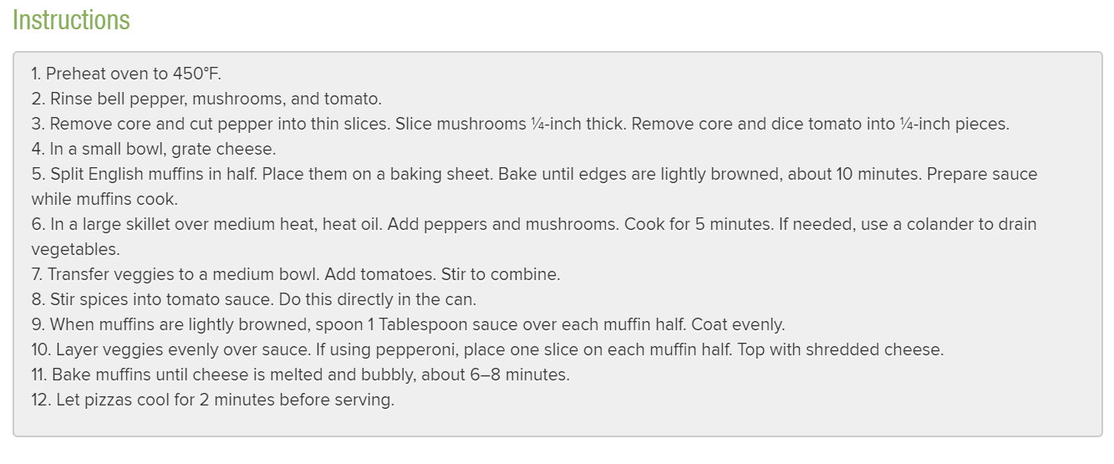
Mini Pizzas
Please share:
What are ways you could involve your children in making homemade pizza?
Notes:
Optional if time permits, another recipe idea to do with children.
Talking Points for Mini-Pizzas:
SHARE: Depending on their age, your kids can measure the spices, rip up spinach for topping the pizza, or they can help stir the sauce.
Pizza is such a comfort food, which can make it easier to couple vegetables with when serving to your kids. If your kids are not ready to see the veggies on their pizza, you can just add grated carrot to the tomato sauce – the red of the tomato conceals the carrot and your kids may not even know it is there!
This recipe is a great example of how kids can be involved in food decisions. You can follow the directions and prepare the toppings as suggested or your kids can choose their favorite veggies to top the pizza.

Slide 9
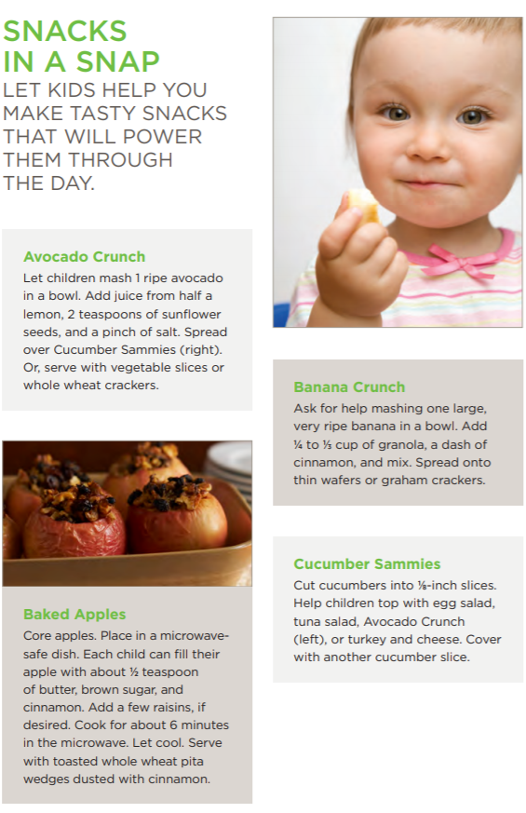
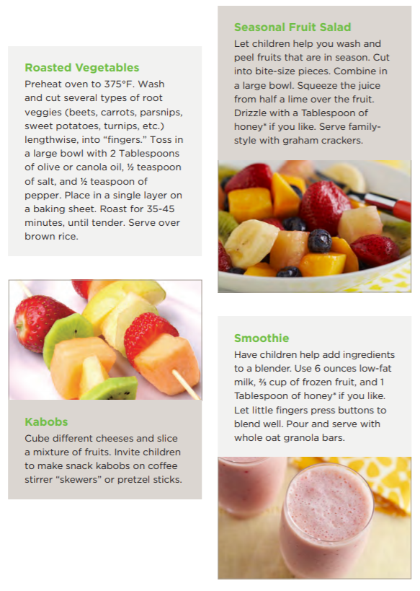
Notes:
These snacks are included in the Cooking Matters at Home packet on our website and are great ideas for quick and healthy options children can help make or assemble. Remember, children are more likely to eat foods that they helped create or choose.
ASK: Do you see any recipes here that you might like to try with your children?

Slide 10
Please share:
How do you feel about children scrubbing and peeling veggies, cracking eggs, helping you gather ingredients?
Notes:
SHARE:
Add to the discussion as needed, emphasizing that cooking and eating together promote positive eating habits for the whole family, teaches kids responsibility and builds self-confidence, and makes meal time more fun.
Share that kids tend to want to eat what they helped make, which could reduce the need to make separate meals. And, if kids are bought-in on the meal, there will be less food rejection and as a result, less food waste.

Slide 11
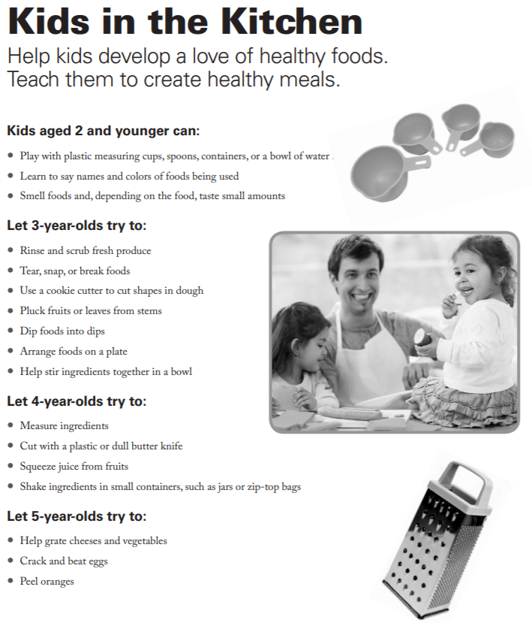
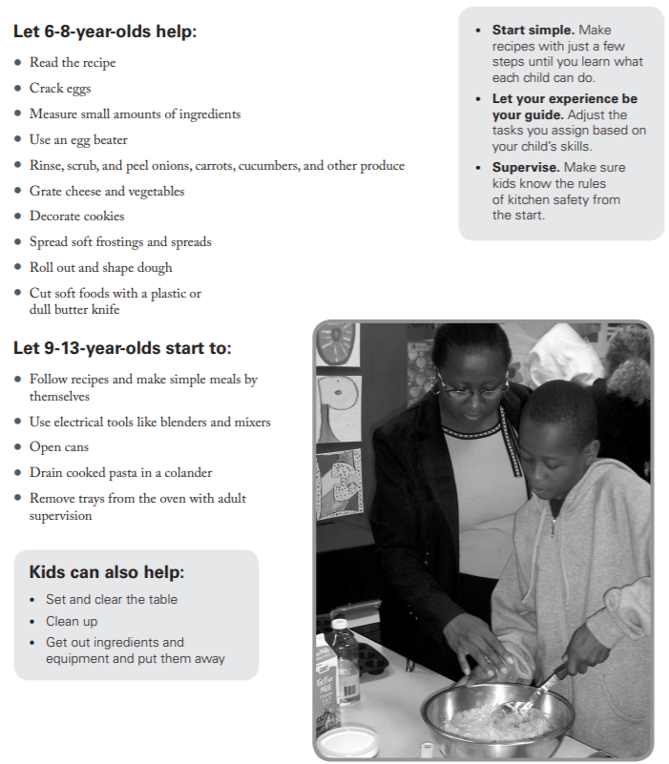
Notes:
ASK: What are some other things your children get excited about helping with in the kitchen?
If caregivers mention concerns or challenges with having kids help in the kitchen, take time to discuss challenges and possible solutions using the "Getting Kids in the Kitchen to Help" chart from your Facilitator Guide.

Slide 12
What does it mean to be a role model for your kids around healthy eating?
How are you doing this already?
In what ways might you be modeling unhelpful behaviors or attitudes towards food?
Notes:
Discuss with caregivers why it’s important to them that their families eat healthy. Point out that one of the most important things caregivers can do to encourage healthy habits is to model the behaviors they want kids to adopt – both in the kitchen and at mealtime.
Validate caregivers’ thoughts and opinions using a white board or chart paper. Affirm the many positive things caregivers are already doing.

Slide 13
Notes:
Refer to the Set a Healthy Example handout. Point out other simple modeling behaviors and encourage caregivers to circle or write down ideas they’d like to try.
Remind caregivers that modeling is a long-term strategy. Just like so many other milestones in early childhood development, children need to see skills modeled many times in order to learn how to do themselves. Patience works better than pressure.

Slide 14
How would it make you feel if I told you that you had to eat a certain food or I gave you only one pre-made option to eat?
How might you address this in your household?
Notes:
Point out that an adult rarely orders something at a restaurant without understanding what all the ingredients are, yet we often expect kids to eat new foods with no questions asked! Allowing your kids to ask questions about the food they eat or to participate in making it or choosing ingredients can help them develop healthy habits. Their buy-in can also save you time and money.

Slide 15
Please share:
How might you react if you involve your children in the food preparation and they still won’t eat the food?
Notes:
SHARE: Acknowledge that feeding young children can be really challenging! Sometimes, no matter your best effort, your family won’t eat or enjoy the foods prepared. Have caregivers share ideas for how to handle this challenge. Additional ideas below;
1. Allow children to serve themselves, that way you are respecting their independence and they feel in control, even though you are the one deciding the meal components. When children feel like the choice is theirs, they are more willing to try something!
2. Have children taste-test the components of the meal instead of offering everything at once. Maybe they’ll eat everything but the sauce you put on at the end. Congratulate them on trying new tastes and add just the components they enjoy right now to their plate.
3. Make sure that you always include a healthy food you know the child will like in the meal. This way they can try new foods, but there is always a “safe bet.”
4. Involve them in the process. This can include planning, shopping, gathering ingredients, setting the table, actual food prep, clean up.

Slide 16
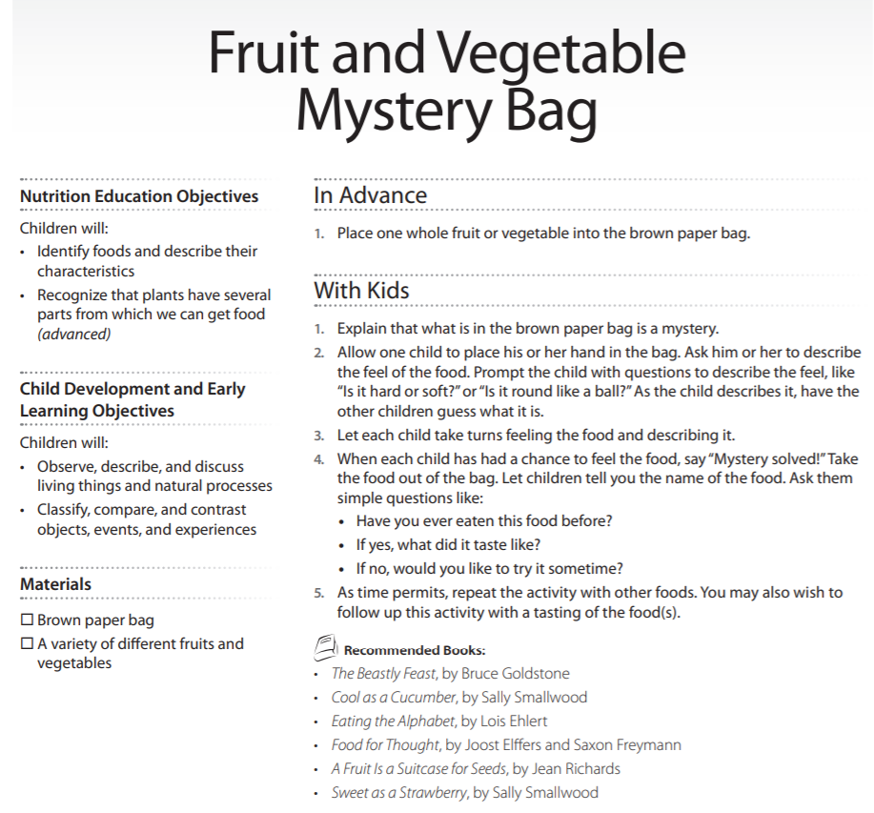

Notes:
SHARE: One example of a child’s activity from The Family Kitchen List;
For younger kids:
Vegetable Toss- Cooking Matters at Home page
Any of the coloring sheets on pages 21-32 from Exploring Food Together
For older kids:
Fruit and Vegetable Mystery Bag Game page 2 Exploring Food Together
Any of the crosswords or word-searches in Cooking Matters At Home
We have provided a booklet of activities that can be used with kids during the Coronavirus Crisis for you to pass on to caregivers.
Download Exploring Food Together in English.

Slide 17
Today’s Top Tips
Make your job easier. Kids are more likely to try new foods when they help choose and prepare them.
Start young. Kids can help in the kitchen as early as their toddler years.
Keep calm and cook on – working with kids in the kitchen may be messy. The more you practice, the better you’ll get at figuring out what kitchen jobs are right for each of you.
Notes:
Encourage participants with the following tips for making it work at home:
Set a goal, start small. Choose one new thing you’d like to try this week. Then keep it up — once it’s an easy habit (and that might take weeks or months!), pick another new thing you want to try.
Remember that setbacks will happen! That’s ok
— it’s not all or nothing. We all have days or weeks that go off course. Start back with one small habit and take it from there. The good news is that once you’ve set new habits, it’s easier and faster to get back on track the next time!

Slide 18
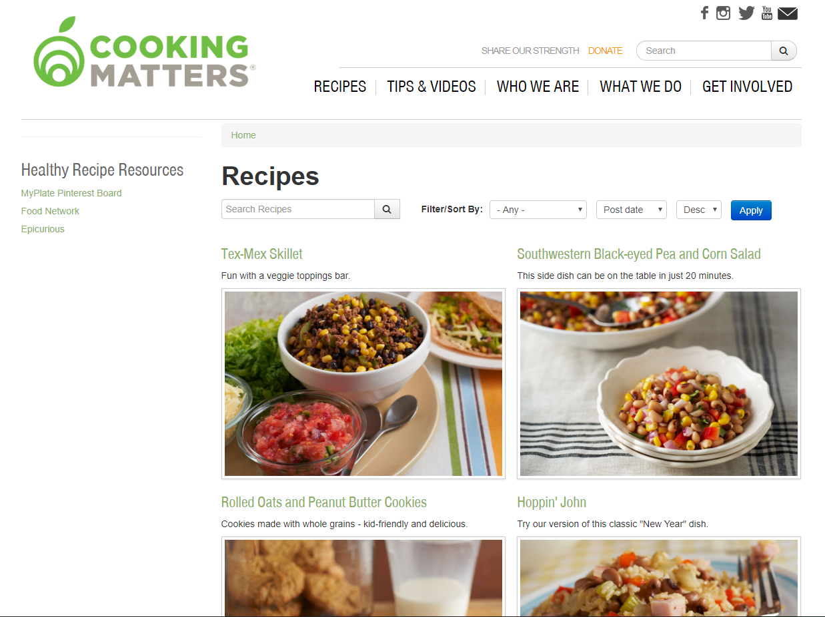
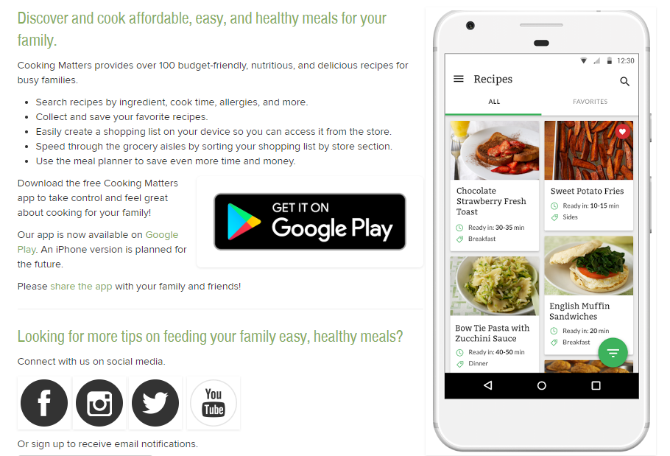
Recipe Resources
Cooking Matters App
Cookingmatters.org/recipes
Notes:
SHARE: Share with participants that they can download the Cooking Matters App for more recipes or go to the Cooking Matters website

Slide 19
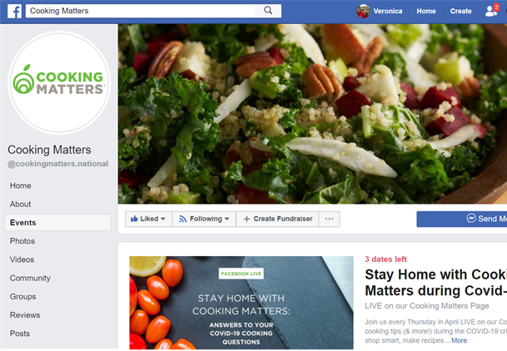
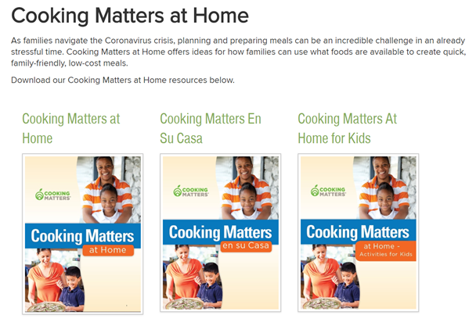
Recipe and Activity Resources
Cookingmatters.org/cooking-matters-home
Cooking Matters Facebook Page
Notes:
SHARE: Share with participants that they can download the Cooking Matters App for more recipes or go to Cooking Matters website.
Encourage participants with the following tips for making it work at home:
Fill your feeds with inspiration. It’s easier to stay motivated when you’ve got regular reminders and tips popping up on your social media feeds. Follow Cooking Matters or other channels that help you get closer to your goals.
Share what you’ve learned. Want other family members and friends to join you on this journey? Share something exciting you’ve learned — or better yet, feed them something delicious and healthy so they’ll know it’s true! Don’t pressure them — let them decide when they’re ready to take on new habits themselves.

Slide 20
Thank you!
After this session you will receive an e-mail with a quick survey and links to our resources.
If you have time, please fill out the survey to help us know who we are serving and how we can make our programs better!
Notes:
Closing (5 minutes)
ENCOURAGE: Encourage caregivers to choose one thing they learned today that they will commit to trying at home this week. Have them type in their answers.
SHARE: Open at least one child activity from the list below and explain how they can do this at home with kids. Share with participants that they can download the Cooking Matters App or the Cooking Matters website for more recipes, and there are additional resources available on our Facebook and YouTube pages. Share any other upcoming online programs.

